Slide 1
Chapter 4: Measures of Location

Slide 2
Learning Outcomes
After Completing the chapter ,you will able to :
Compute the different types of measures of location.
Understand the applications of different types of measures of location.

Slide 3
Contents
    From this lecture, you are going to learn…
Types of Measures of location.
Computation of Quartile, Decile and Percentile.

Slide 4
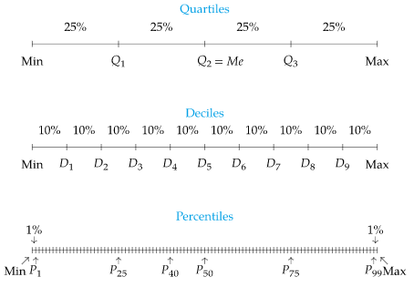
Measures of location
50%
Median
50%
We have learned that the median divides a set of data into two equal parts.
In the same way, there are also certain other values which divide a set of data into four, ten or hundred equal parts.

Slide 5
Types of Measures of location
Measures of Location
Quartile
Decile
Percentile

Slide 6
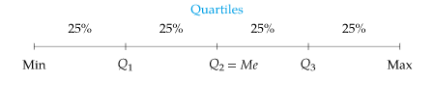
Quartiles
To divide the data set into 4 equal parts , 3 points are needed. These points are called quartiles.

Slide 7












Quartile

Slide 8
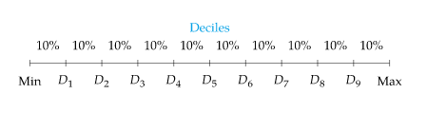




Deciles
To divide the data set into 10 equal parts , 9 points are needed. These points are called Deciles.
…………………………………………………………

Slide 9
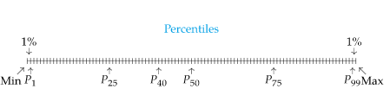






Percentile
To divide the data set into 100 equal parts , 99 points are needed. These points are called Percentiles.
…………
…………

Slide 10



Steps of getting Quartiles
Steps to get Quartiles
Step 1: Arrange the data values from smallest to largest with n= no. of observations.
Step 2:
Step 3:
If j is an integer value
or
If j is not an integer value
Take the next integer value as the position

Slide 11


Example of Quartile calculation
Solution:
Arranging the data to the smallest to largest,
50, 64, 70, 78, 88, 94.
Where, i= 1,2,3.
n= no. of observations= 6
[Since not integer]

Slide 12



Example of Quartile calculation
[Since integer]
[Since not integer]

Slide 13





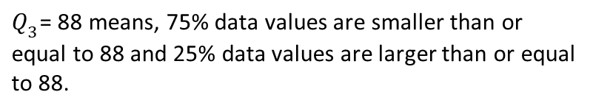
Interpretation of quartiles
Interpretation:
50, 64, 70, 78, 88, 94

Slide 14



Steps of getting
Deciles & Percentiles
Steps to get Deciles and Percentiles (similar as quartiles):
Step 1: Arrange the data values from smallest to largest with n= no. of observations.
Step 2:
Position of Deciles:
Position of percentiles:
Step 3:
If j is an integer value
or
If j is not an integer value
Take the next integer value as the position

Slide 15


Calculation of Decile and percentile
Example:
The number of nuclear power plants in the top 15 nuclear power-producing countries in the world are listed. (Source: International Atomic Energy Agency)
7, 20, 16, 6, 58, 9, 20, 50, 23, 33, 8, 10, 15, 16, 104
Solution:
Arranging the data to the smallest to largest,
6, 7, 8, 9, 10, 15, 16, 16, 20, 20, 23, 33, 50, 58, 104.

Slide 16

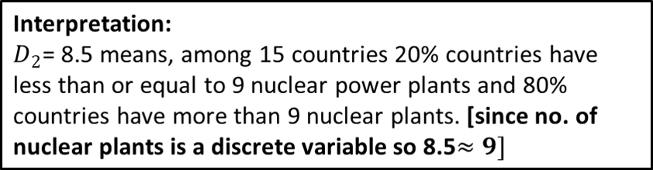
Calculation of Decile and percentile
6, 7, 8, 9, 10, 15, 16, 16, 20, 20, 23, 33, 50, 58, 104.
20%
80%

Slide 17



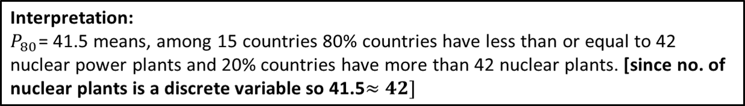
Calculation of Decile and percentile
6, 7, 8, 9, 10, 15, 16, 16, 20, 20, 23, 33, 50, 58, 104.
80%
20%

Slide 18
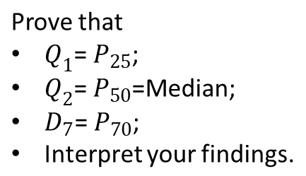
Do yourself
For the previous math:

Slide 19
Exercises….
Find the Q₃ , D₇, P₃₉ and P₈₅ of the following numbers.
12, 5, 22, 30, 7, 36, 14, 42, 15, 53, 25, 65
Find 2nd Quartile, 7th Decile, 5th Percentile and 68th Percentile from the following data.
30,37,5,9,74,35,25,46,38,6,12,17,54,48,50,81,35.
Age of 19 people are given below:
50,2,77,37,64,25,20,30,32,19,45,18,23,50,7,28,32,21,30.
Find the ages of 60% people, 15% people, 80% people and 50% people.

Slide 20


